Slide 1

ELL-884 Deep Learning for Natural Language Processing (Mini Project)
Detection of Sarcastic News Headlines
Team Stark
Pulkit Singal (2023AIB2064)
Ajay Tomar (2023AIB2071)
Shashwat Bhardwaj (2023AIY7528)
January 2024 – May 2024
“You shall know a word by the company it keeps” (J. R. Firth, 1957)
Team Stark
Detection of Sarcastic News Headlines
1

Slide 2
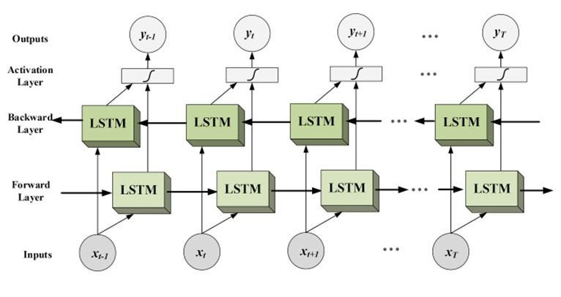
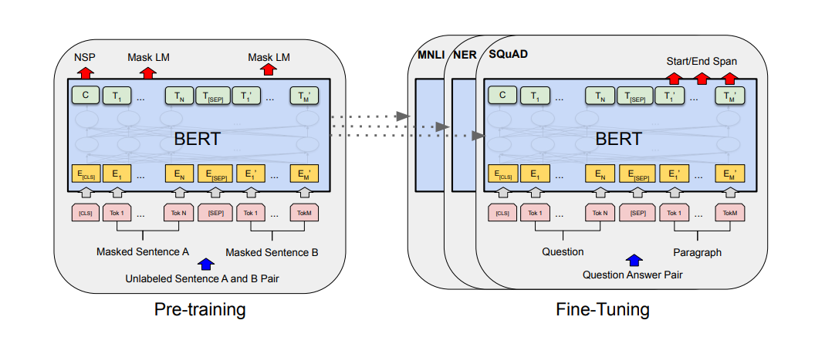
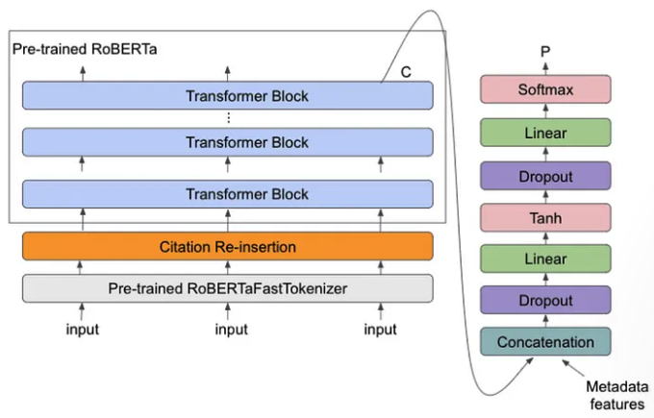
Models Used
Bidirectional LSTM
BERT
RoBERTa
Team Stark
Detection of Sarcastic News Headlines
2

Slide 3
Bidirectional LSTM (Baseline Model)
Team Stark
Detection of Sarcastic News Headlines
3

Slide 4
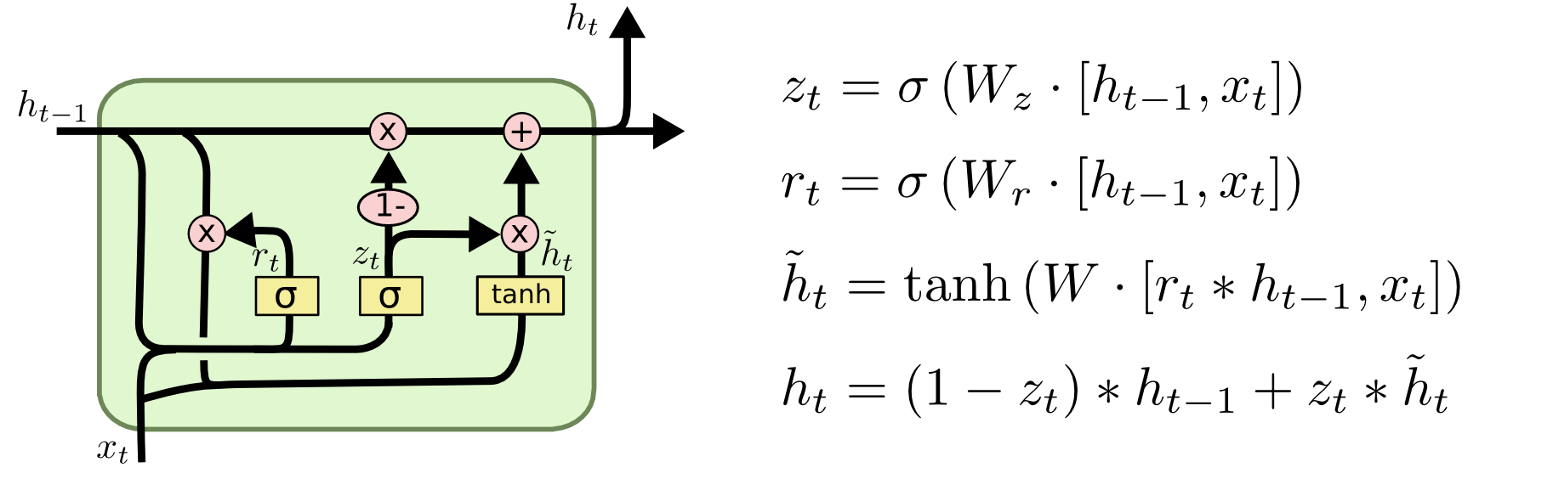
Bidirectional LSTM (Baseline Model): Introduction
RNN: Recurrent Neural Network
Solves limited sequence length problem
Drawback: Vanishing Gradient problem
LSTM: Long Short Term Memory
Forget gate: Controls what is kept vs forgotten, from the previous cell state
Input gate: Controls what parts of the new cell content are written to the cell
Output gate: Controls what parts of the cell are output to hidden state
Long context available!
But doesn’t provide bidirectional context for tasks like classification
BiLSTM: Bidirectional LSTM
LSTM in both directions
Concatenation of outputs of both LSTMs to get a single output
Provides long bidirectional context!
Team Stark
Detection of Sarcastic News Headlines
4

Slide 5
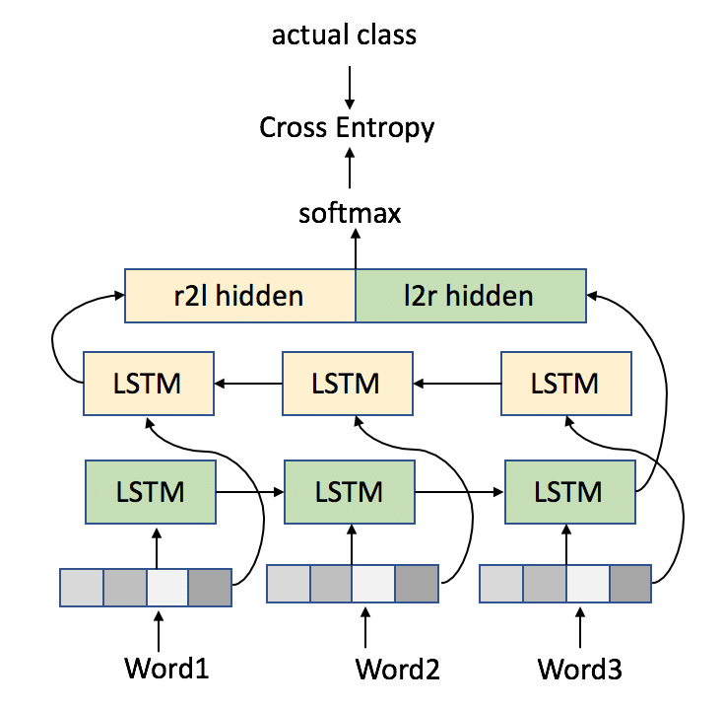
Bidirectional LSTM (Baseline Model): Implementation
Architecture Parameters:
Tokenizer = torchtext.data.utils.get_tokenizer('basic_english’)
Vocabulary size (|V|) = 27235
Embedding dimension (d) = 100
Hidden state dimension (h) = 256
Number of layers (LSTM) = 2
Dropout (LSTM) = 0.5
1 X 1
2h X 1
Training Parameters:
h X 1
h X 1
h X 1
Loss Function = Binary Cross Entropy
Optimizer = Adam
Learning Rate = 0.001
Number of Epochs = 15
h X 1
h X 1
h X 1
d X 1
d X 1
d X 1
Team Stark
Detection of Sarcastic News Headlines
5

Slide 6
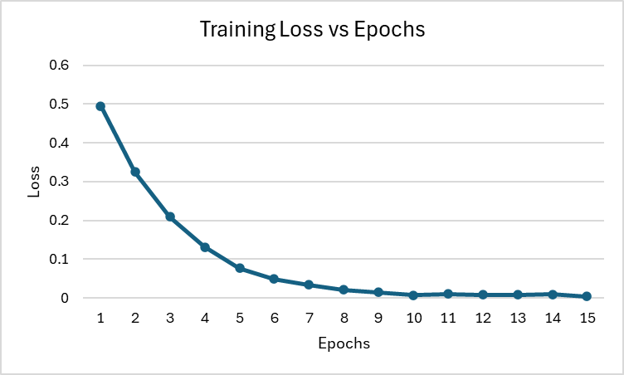
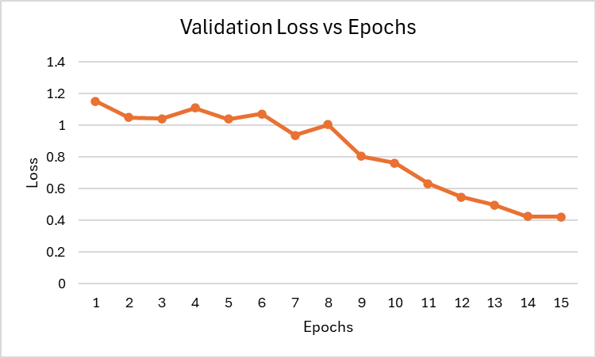
Bidirectional LSTM (Baseline Model): Loss Curves
Team Stark
Detection of Sarcastic News Headlines
6

Slide 7
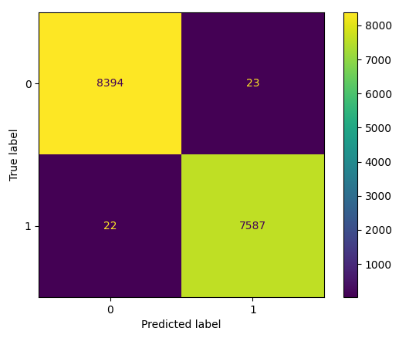
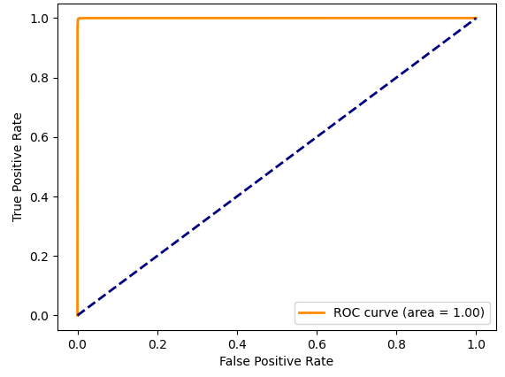
Bidirectional LSTM (Baseline Model): Training Data Results
Receiver ​
Operating ​
Characteristic
(ROC) Curve​​
Confusion​
Matrix​​
Training Data
Class | Precision | Recall | F1-Score | Support
0 | 1.00 | 1.00 | 1.00 | 8417
1 | 1.00 | 1.00 | 1.00 | 7609
Accuracy |  |  | 1.00 | 16026
Macro Avg. | 1.00 | 1.00 | 1.00 | 16026
Weighted Avg. | 1.00 | 1.00 | 1.00 | 16026
Classification
Report ​​
Team Stark
Detection of Sarcastic News Headlines
7

Slide 8
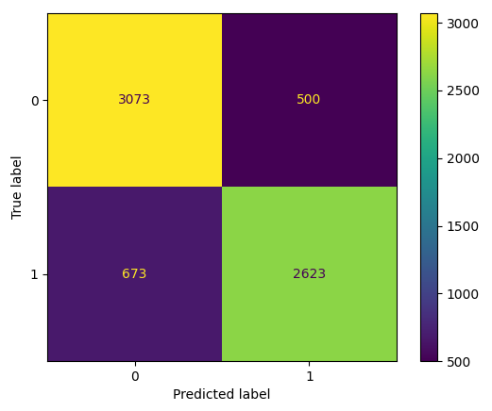
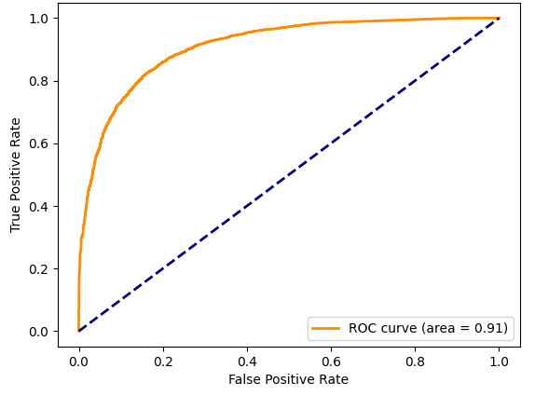
Bidirectional LSTM (Baseline Model): Validation Data Results
Receiver ​
Operating ​
Characteristic
(ROC) Curve​​
Confusion​
Matrix​​
Validation Data
Class | Precision | Recall | F1-Score | Support
0 | 0.82 | 0.86 | 0.84 | 3573
1 | 0.84 | 0.80 | 0.82 | 3296
Accuracy |  |  | 0.83 | 6869
Macro Avg. | 0.83 | 0.83 | 0.83 | 6869
Weighted Avg. | 0.83 | 0.83 | 0.83 | 6869
Classification
Report ​​
Team Stark
Detection of Sarcastic News Headlines
8

Slide 9
BERT
(Bidirectional Encoder Representations from Transformers)
Pulkit Singal
Detection of Sarcastic News Headlines
9

Slide 10
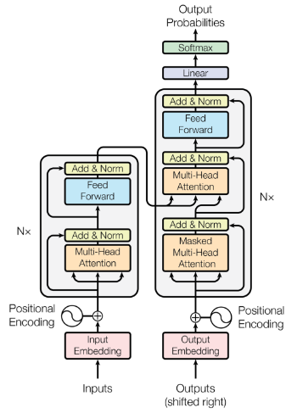
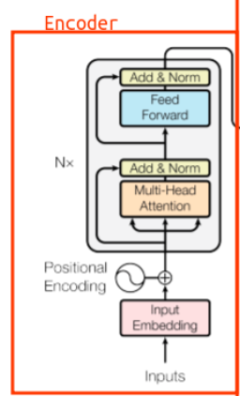
BERT: Introduction
Benefits:
Linear Interaction Distance: O(Seq Length) -> O(1)
Parallelizability
Using Transformer
Bidirectional context captured
Pretraining on large unlabeled corpora
Fine-tuning on specific tasks
Multiple layers and attention heads for diverse linguistic patterns
Large-scale pretraining on billions of words
Contextual embeddings for word meanings in context
Fine-grained representations: token, segment, positional embeddings
Team Stark
Detection of Sarcastic News Headlines
10

Slide 11
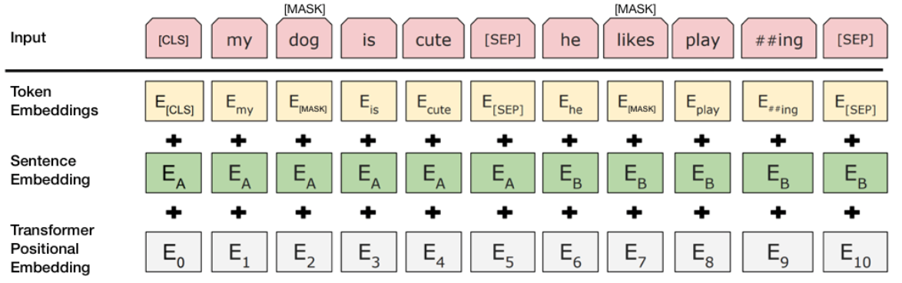
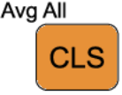
BERT: Technical Aspects
BERT utilizes a tokenization technique called WordPiece, handling out-of-vocabulary words efficiently.
It consists of transformer encoder layers with self-attention and feedforward networks.
BERT employs NSP in pretraining to capture relationships between consecutive sentences.
It employs MLM in pretraining to predict masked tokens, enhancing bidirectional context understanding.
BERT has the token, capturing the context of the entire sentence.
BERT incorporates layer normalization after each sublayer, aiding stable training and better generalization.
Team Stark
Detection of Sarcastic News Headlines
11

Slide 12
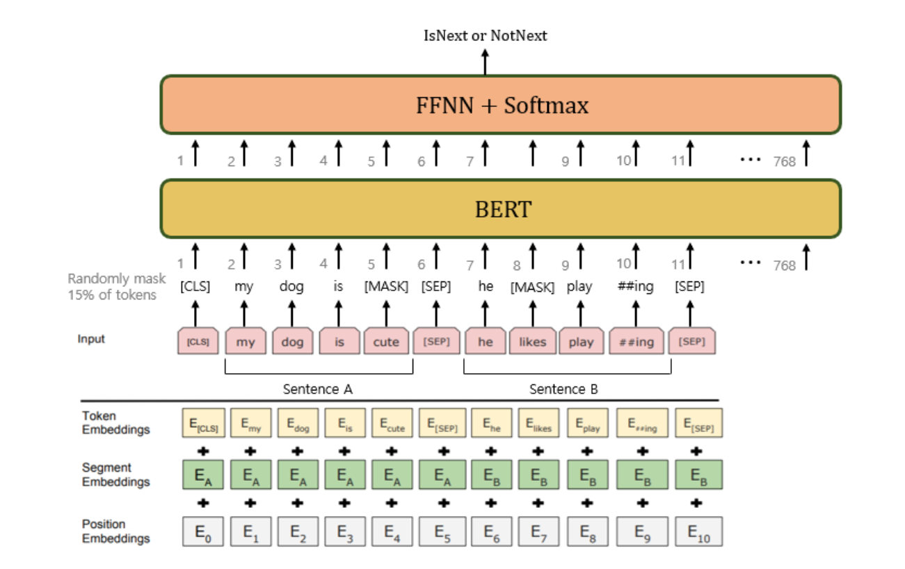
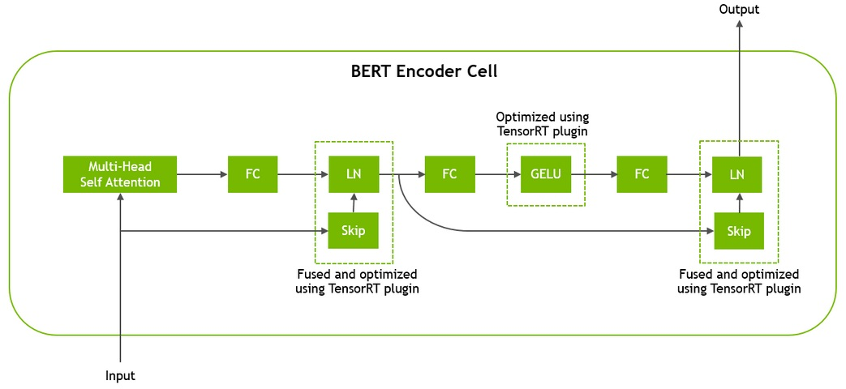
BERT: Implementation Details
In our implementation, we:
Imported the model from transformers module
Trained the model from scratch for classification problem
Used the model for inference
Team Stark
Detection of Sarcastic News Headlines
12

Slide 13
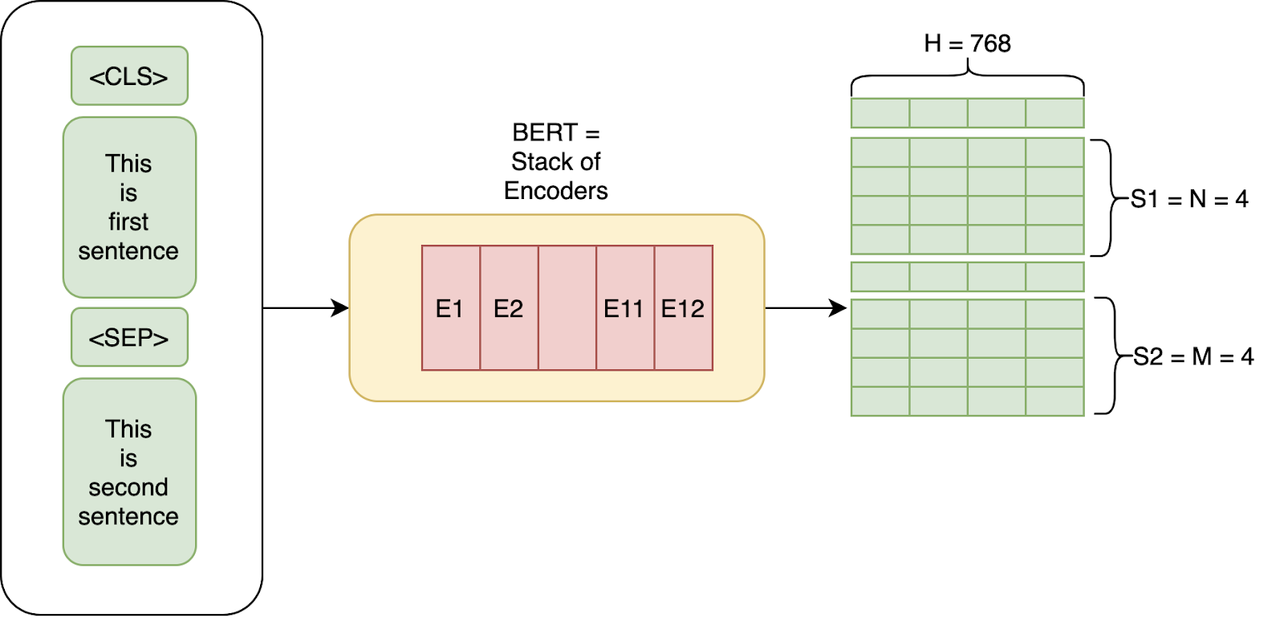
BERT: Implementation
Architecture Parameters:​
Tokenizer = BertTokenizer.from_pretrained(‘bert-base-uncased’)
Layer 1: BertModel.from_pretrained(‘bert-base-uncased’)
Layer 2: Dropout (0.3)
Layer 3: Linear (768, 1)
Training Parameters:​
Loss Function = Binary Cross Entropy​
Optimizer = Adam​
Learning Rate = 0.00001​
Number of Epochs = 15
Team Stark
Detection of Sarcastic News Headlines
13

Slide 14
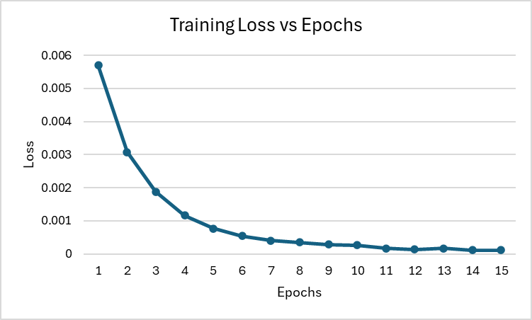
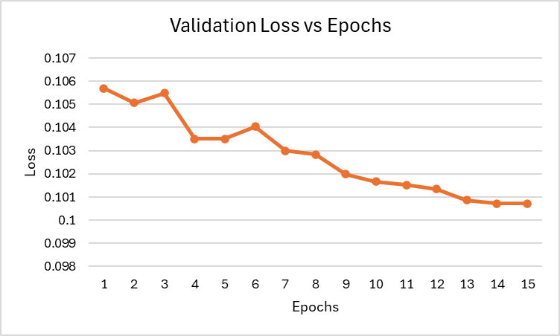
BERT: Loss Curves
Team Stark
Detection of Sarcastic News Headlines
14

Slide 15
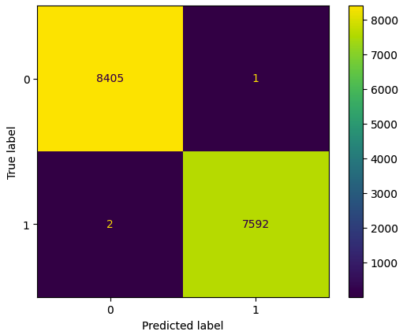
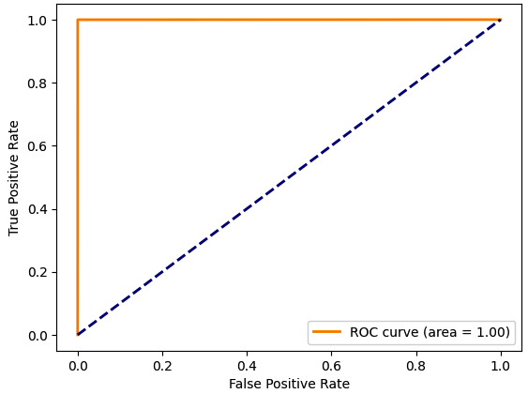
BERT: Training Data Results
Receiver ​
Operating ​
Characteristic
(ROC) Curve​​
Confusion​
Matrix​​
Training Data
Class | Precision | Recall | F1-Score | Support
0 | 1.00 | 1.00 | 1.00 | 8406
1 | 1.00 | 1.00 | 1.00 | 7594
Accuracy |  |  | 1.00 | 16000
Macro Avg. | 1.00 | 1.00 | 1.00 | 16000
Weighted Avg. | 1.00 | 1.00 | 1.00 | 16000
Classification
Report ​​
Team Stark
Detection of Sarcastic News Headlines
15

Slide 16
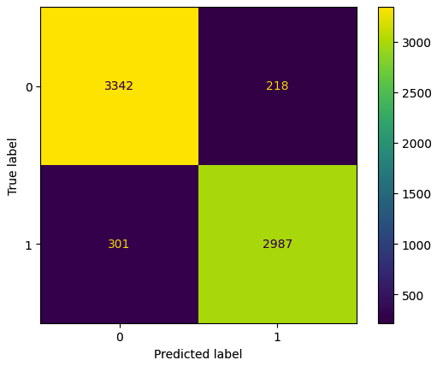
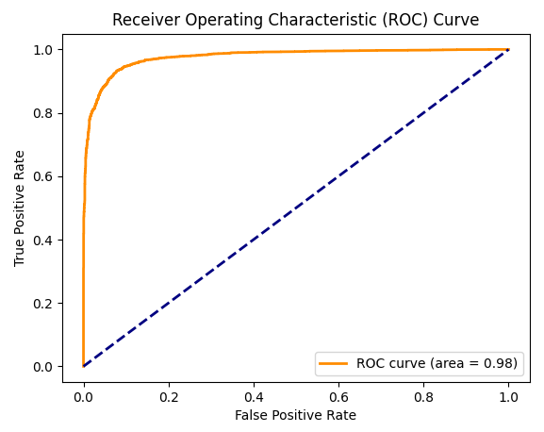
BERT: Validation Data Results
Receiver
Operating
Characteristic (ROC) Curve​
Confusion
Matrix​
Validation Data
Class | Precision | Recall | F1-Score | Support
0 | 0.92 | 0.94 | 0.93 | 3560
1 | 0.93 | 0.91 | 0.92 | 3288
Accuracy |  |  | 0.92 | 6864
Macro Avg. | 0.92 | 0.92 | 0.92 | 6864
Weighted Avg. | 0.92 | 0.92 | 0.92 | 6864
Classification Report ​
Team Stark
Detection of Sarcastic News Headlines
16

Slide 17
RoBERTa (Robustly optimized BERT approach)
Team Stark
Detection of Sarcastic News Headlines
17

Slide 18
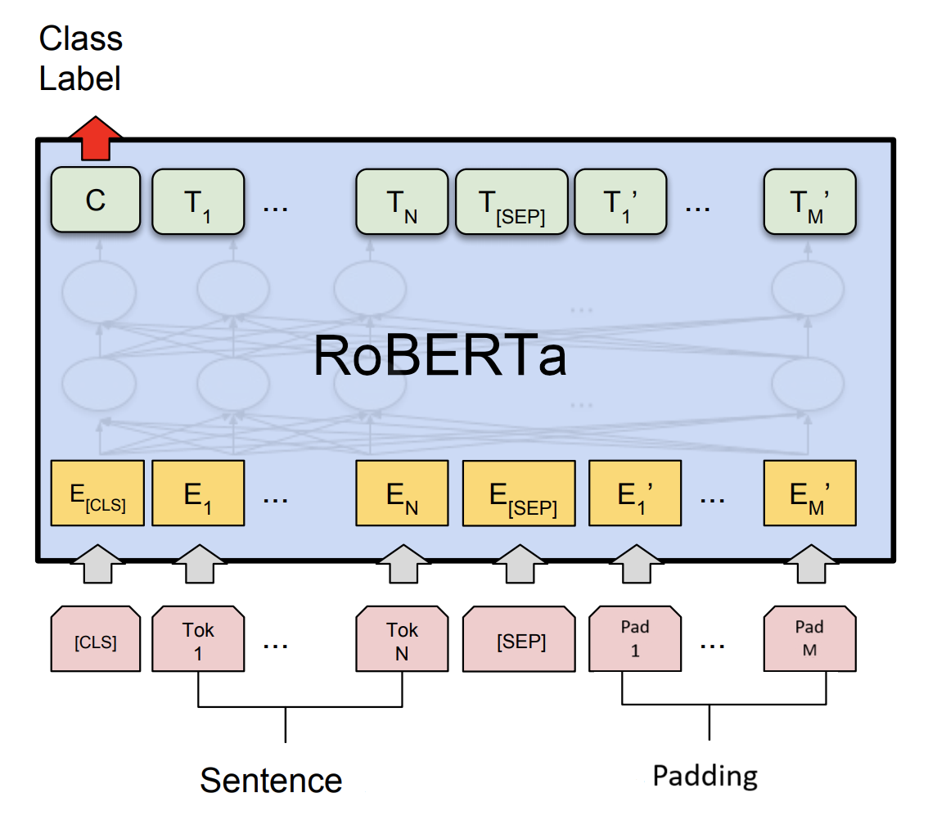
RoBERTa: Introduction
Architecture (Encoder-only Transformer):
Self Attention
Add and Norm
Feed Forward Network
Add and Norm
Pre-training:
More training data
Masked Language Modelling (like BERT)
Dynamic Masking Strategies
No Next Sentence Prediction (NSP)
Applications:
Classification
Sentiment Analysis
Question Answering
Provides bidirectional context!
Team Stark
Detection of Sarcastic News Headlines
18

Slide 19
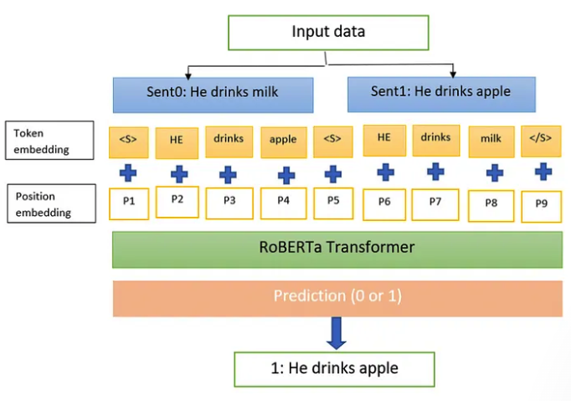
RoBERTa: Working
Pre-training:
Pre-training on a large text corpus
Randomly masking of a fraction of the tokens in each phrase
Training to predict the masked tokens based on the context provided by the unmasked tokens
Fine-tuning:
Training on a smaller dataset that is specific to the task at hand, utilizing the pre-learned weights as initialization
Fine-tuning for specific NLP tasks, including NER, sentiment analysis, or QA
Inference:
Utilizing the model for inference on a new text, using the learned representations to make predictions
Loss
0: He drinks milk
Team Stark
Detection of Sarcastic News Headlines
19

Slide 20
RoBERTa: Implementation
Actual Class
Architecture Parameters:​
Cross Entropy
Tokenizer = RobertaTokenizer.from_pretrained(‘roberta-base’)
Layer 1: RoBERTaModel.from_pretrained(‘roberta-base’)
Layer 2: Dropout (0.3)
Layer 3: Linear (768, 1)
Softmax
Layer 3: Linear
Training Parameters:​
Layer 2: Dropout
Loss Function = Binary Cross Entropy​
Optimizer = Adam​
Learning Rate = 0.00001​
Number of Epochs = 15
Layer 1: RoBERTa
Embeddings
Team Stark
Detection of Sarcastic News Headlines
20

Slide 21
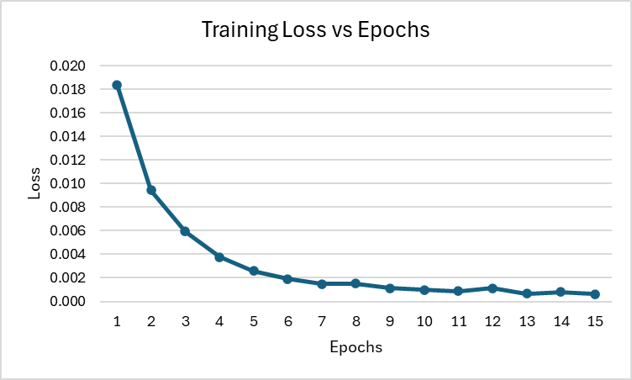
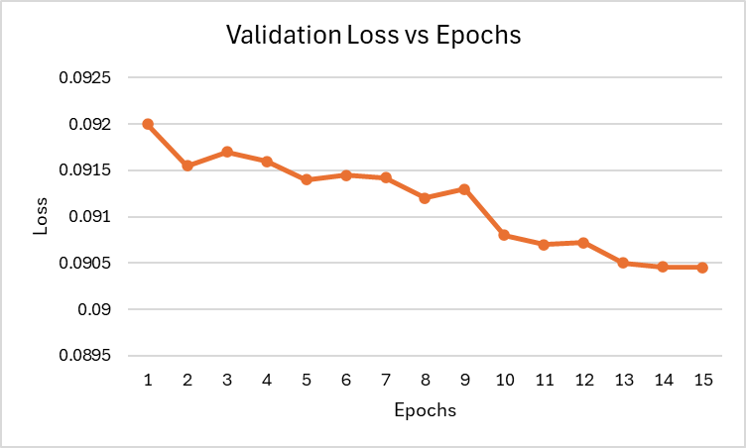
RoBERTa: Loss Curves
Team Stark
Detection of Sarcastic News Headlines
21

Slide 22

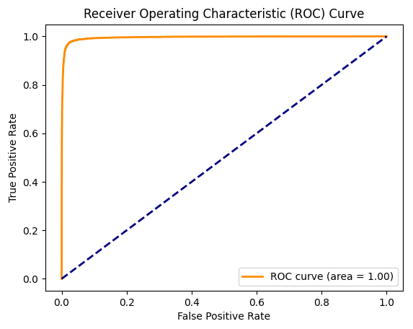
RoBERTa: Training Data Results
Receiver
Operating
Characteristic (ROC) Curve​
Confusion​
Matrix​
Training Data
Class | Precision | Recall | F1-Score | Support
0 | 0.96 | 0.99 | 0.97 | 8411
1 | 0.98 | 0.96 | 0.97 | 7605
Accuracy |  |  | 0.97 | 16016
Macro Avg. | 0.97 | 0.97 | 0.97 | 16016
Weighted Avg. | 0.97 | 0.97 | 0.97 | 16016
Classification​
Report ​
Team Stark
Detection of Sarcastic News Headlines
22

Slide 23
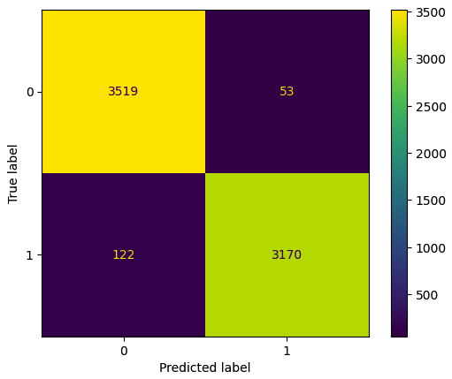
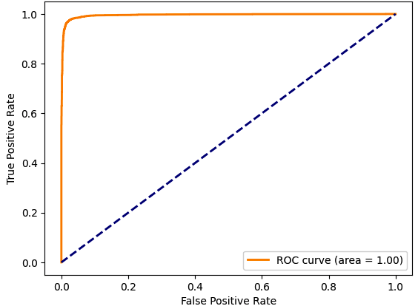
RoBERTa: Validation Data Results
Receiver Operating Characteristic (ROC) Curve
Confusion
Matrix
Validation Data
Class | Precision | Recall | F1-Score | Support
0 | 0.97 | 0.99 | 0.98 | 3572
1 | 0.98 | 0.96 | 0.97 | 3292
Accuracy |  |  | 0.97 | 6864
Macro Avg. | 0.98 | 0.97 | 0.97 | 6864
Weighted Avg. | 0.97 | 0.97 | 0.97 | 6864
Classification
Report
Team Stark
Detection of Sarcastic News Headlines
23

Slide 24
Test Scores (Kaggle)
Test Score: RoBERTa > BERT > Bidirectional LSTM
Team Stark
Detection of Sarcastic News Headlines
24

Slide 25
Thank You
Team Stark
Detection of Sarcastic News Headlines
25

